Slide 2
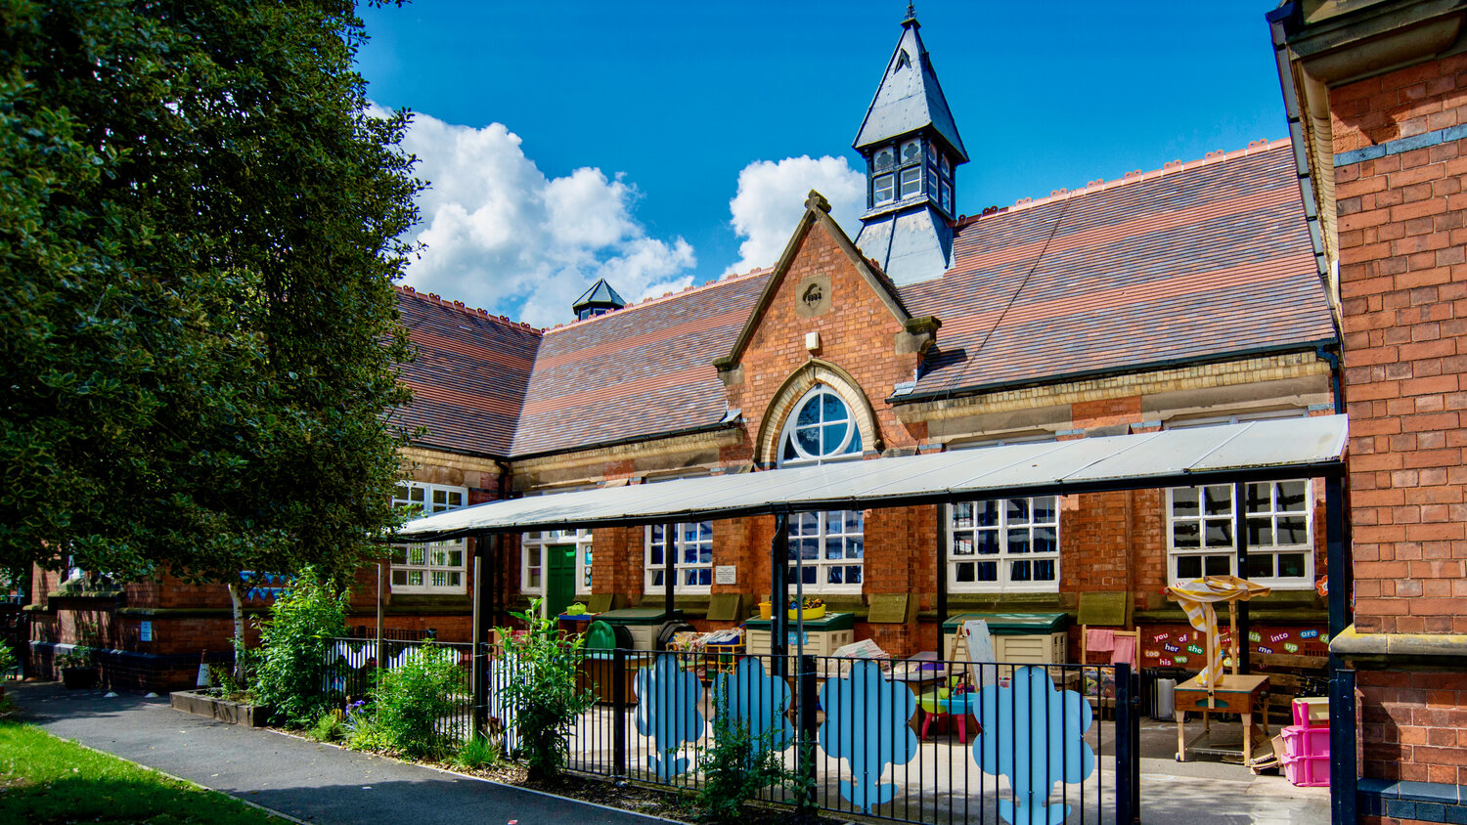
‘Our children blossom through nurture and challenge’

Slide 3
The Early Years Foundation Stage (EYFS)
The EYFS is the first part of the National Curriculum focussing on the children aged 0-5 years.
The philosophy underpinning the EYFS is that every child is unique and that they should be provided with an environment and opportunities that enables them to build strong relationships in order to be independent learners.
These principles fall under
A unique child
Positive relationships
Enabling environment
Learning and development
For more information on the EYFS please visit the school website where you will find a parent guide.

Slide 4
The EYFS is made up of 7 areas of learning and development that are identified as Prime or Specific areas.
Prime Areas
Personal, Social and Emotional development
Physical development
Communication and language
Specific Areas
Literacy
Mathematics
Understanding the world
Expressive art and design

Slide 5
The Characteristics of Effective Learning is also a key part of the EYFS curriculum. The children are regularly observed and provided opportunities to continue developing these important skills.
Playing and exploring
Finding out and exploring
Playing with what they know
Being willing to ‘have a go’.
Active learning
Being involved and concentrating
Keeping in touch
Enjoying achieving what they set out to do
Creating and thinking critically
Having their own ideas
Making links
Choosing ways to do things

Slide 6
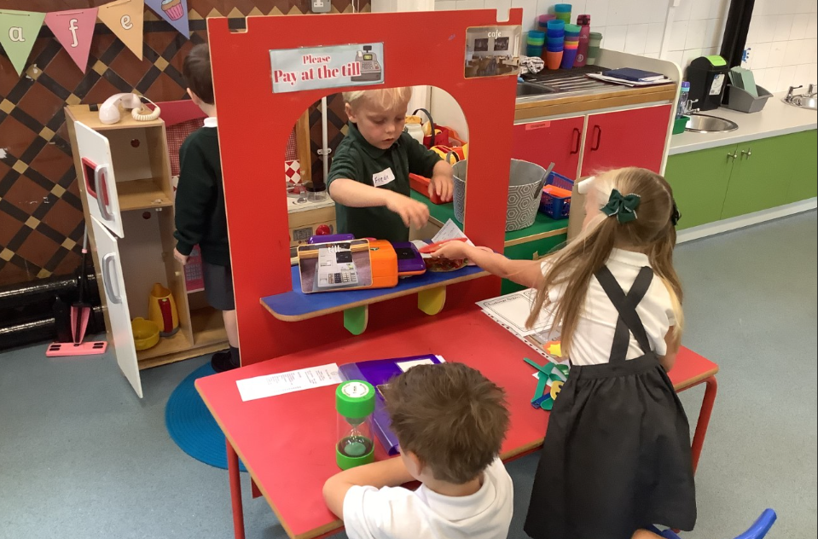
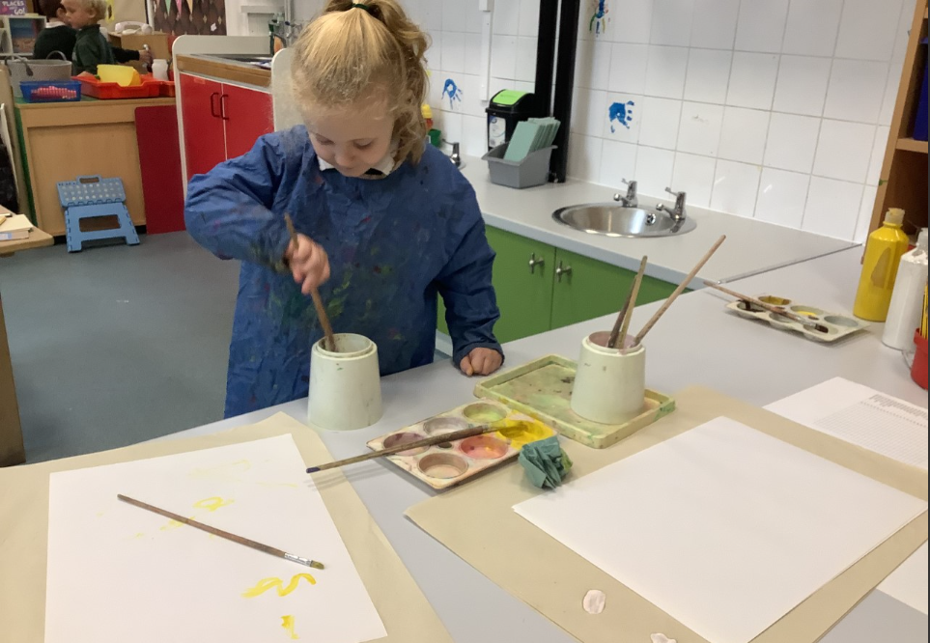
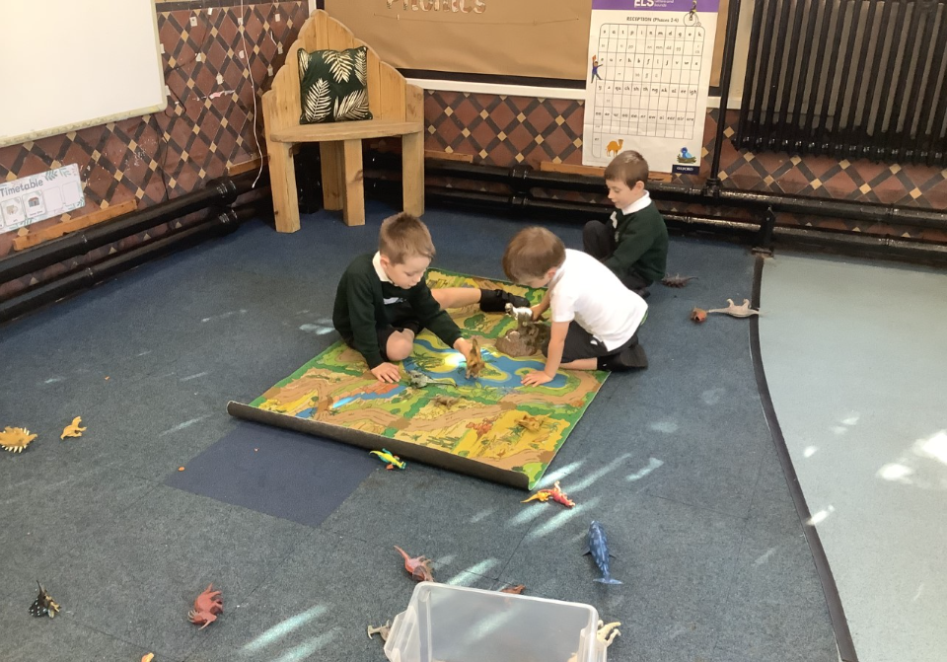
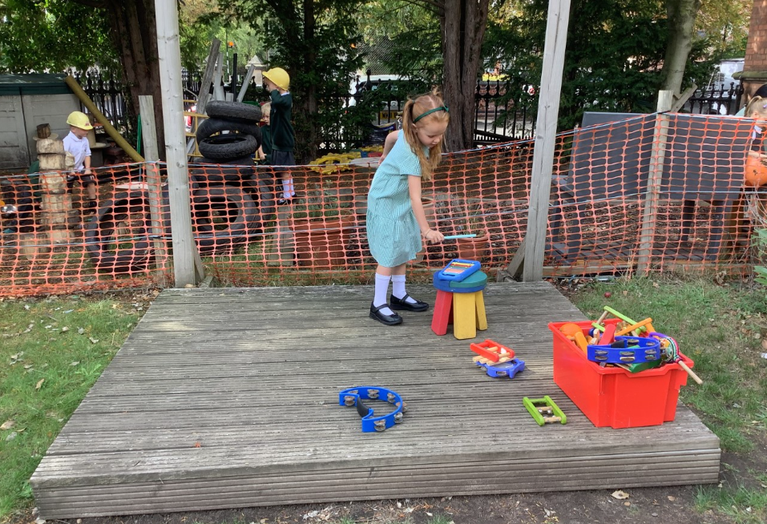
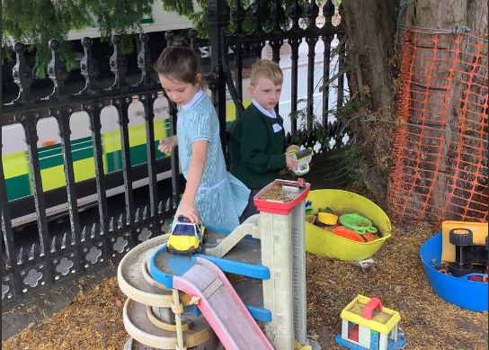
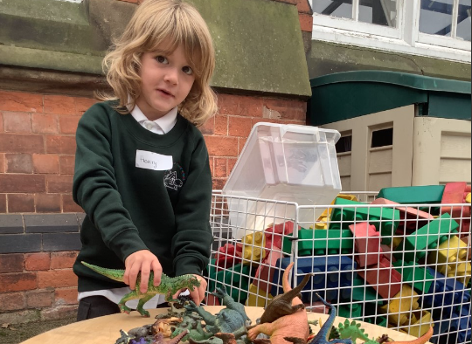
The Reception classroom
Play has a very important role in learning within the EYFS and we provide constant opportunities for play within the classroom! Play provides children with the chance to explore ideas, express emotions and apply new learning in different situations!
The children also access guided activities with an adult throughout the week with a focus on areas across the curriculum.
In EYFS the children learn inside and outside. Please ensure that they are dressed for the weather and bring a coat into school.

Slide 7
Phonics
Our school follows the Essential Letters and Sounds phonics programme (ELS).
It is a key part of our day and the children take part in a 30 minute session every day.
The children are regularly assessed throughout the year (on a weekly and termly basis).
The children receive a reading book that links to the learning taking place in the classroom. In addition to this, they have a ‘shared reader’ which is a story to share and enjoy together. It is more than likely to be beyond their reading level.
If you would like to support your child’s phonic knowledge at home, it is extremely important to follow the guidance available on the website or through the link below.
https://home.oxfordowl.co.uk/reading/reading-schemes-oxford-levels/essential-letters-and-sounds/

Slide 8
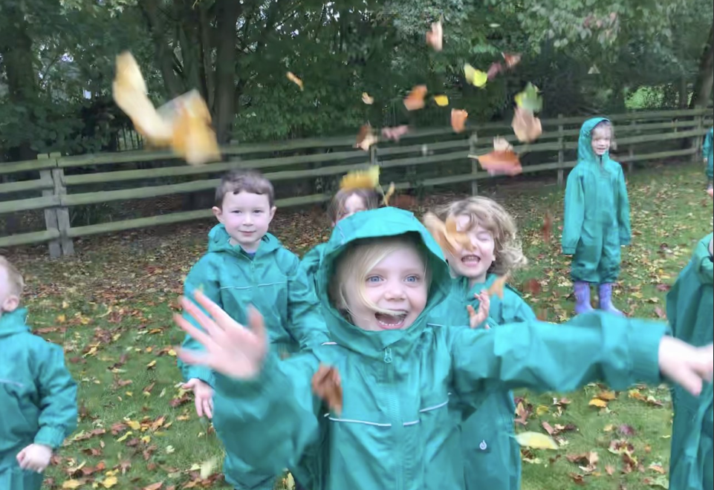
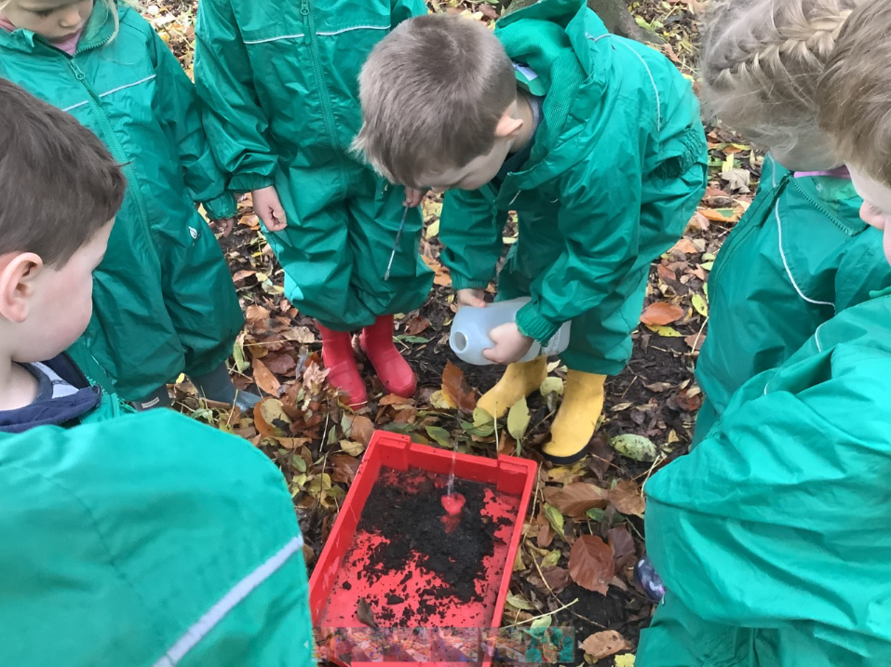
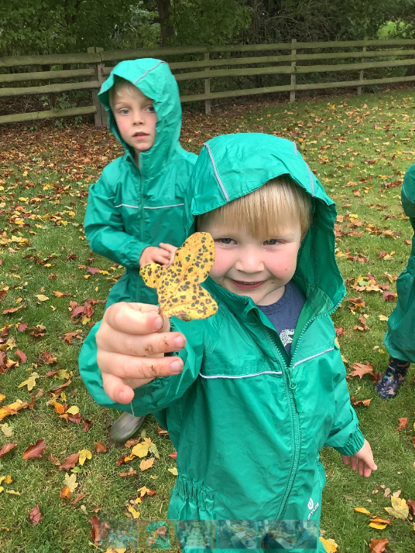
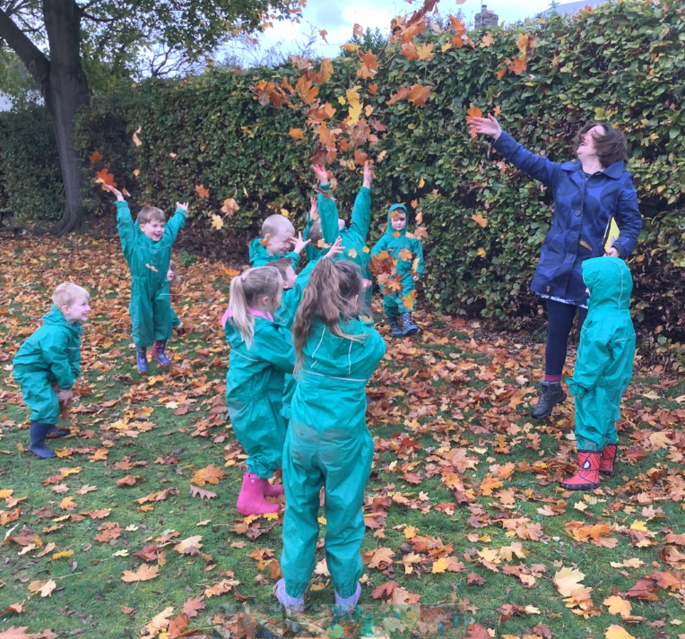
Forest School
Forest School play is a key focus in our school and we are very proud of the opportunities that we can provide for our children throughout the year. In fact we are a Champion Forest school within the National Forest!
Each class takes part in a Forest School session every week.
Children are required to wear long sleeve tops and trousers that you don’t mind getting dirty.
We ask that all children have a pair of wellies in school throughout the year. This is for both forest school session and outdoor continuous provision opportunities.

Slide 9
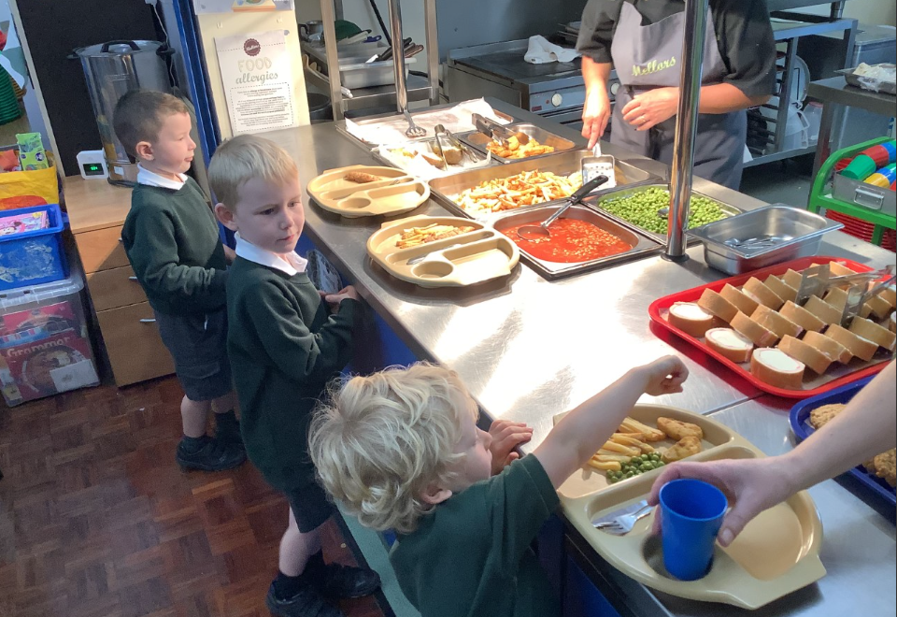
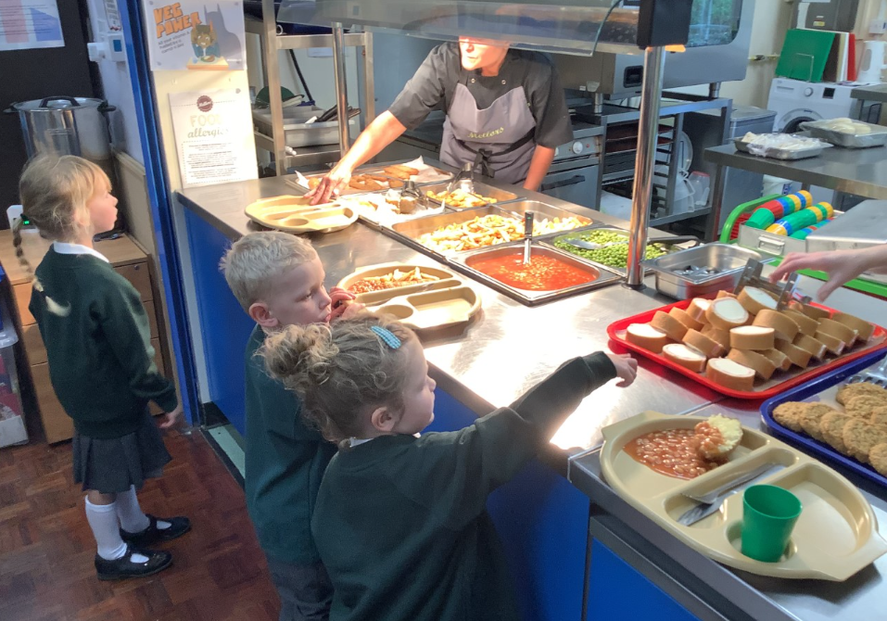
Transition
The children will be attending school on a part time basis in the first week of the academic year. More information on this can be found in your packs.
These sessions include an opportunity for each child to experience lunch during the normal school day.
Our main priority throughout the first weeks in September is to build strong relationships and ensure your children are feeling safe and settled.
In September we will be completing a Baseline assessment of all children. More information can be found on our website in September.

Slide 10
Keeping in touch
In reception we use the online service Tapestry to share learning and to communicate with parents. Permission forms can be found in your pack.
https://home.oxfordowl.co.uk/reading/reading-schemes-oxford-levels/essential-letters-and-sounds/
@trisschool
A school newsletter is sent to all parents on a Friday with dates and additional information you might need to know.

Slide 11
Supporting at home
Read with your children at home! Each day that your child reads at home, goes towards regular reading certificates and prizes.
Hold regular conversations with your children about the learning that is taking place in school. All curriculum maps can be found on the EYFS page on the website.
Mathematical Key Instant Recall Facts (KIRFs) – Each term we have a different mathematical focus. These are shared on a half termly basis. Please practice them at home.
Please share home experiences through Tapestry. Each week we have Tapestry Time where the children share with the rest of the class.
Singing! We use songs to support learning all of the time! We store and share all of the songs that we use on a Padlet. A link will be sent to you all through Tapestry once it is set up.

Slide 12
Before the CHILDREN start
Practise putting on the uniform, including PE kit. The children come to school wearing their kits on PE and Forest School days, but it is always good to practise!
Practise putting on and zipping up coats!
Lots of counting and singing songs.
Practise writing and recognising their name.
Practise putting on and taking off their shoes and wellies by themselves.
Encourage independent personal hygiene e.g. going to the toilet, wiping and washing hands.

Slide 13
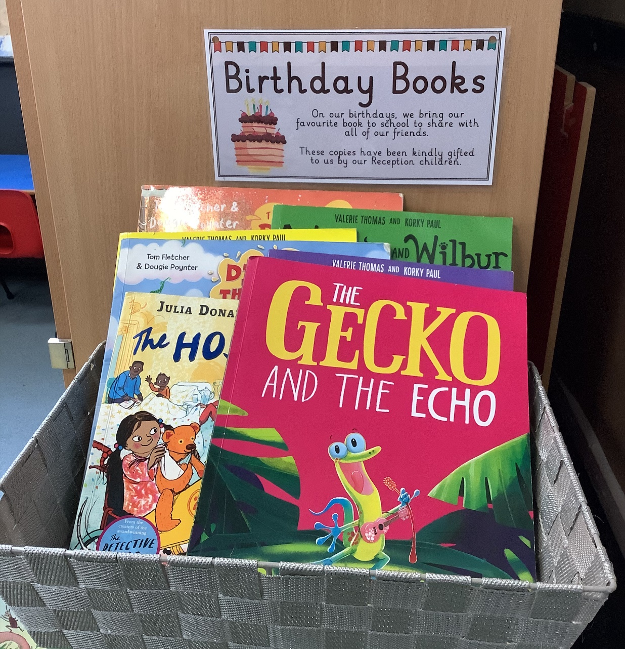
Helpful information
Water Bottles- Please provide your child with a named water bottle that they can open every day. Water only please.
Snack- Children are provided with a free piece of fruit for morning snack every day.
Milk- Children are provided with free milk up until their 5th birthday. After turning 5, children can have milk if you sign up for it. Your child will receive a letter after their 5th birthday with more information.
Universal Free School Meals- Until the end of Year 2, all children are provided with a universal free school dinner. You can send you child with a packed lunch if you wish.
Healthy lunch- We are a healthy eating school and so please provide a healthy packed lunch if you choose to do so.
Birthdays – As we are healthy school we do not accept sweet treats to hand out to celebrate birthdays. Instead we encourage children to bring in a book to share with the class. Sometimes we are lucky enough to be gifted these to go into our Birthday Book Basket!

Slide 14
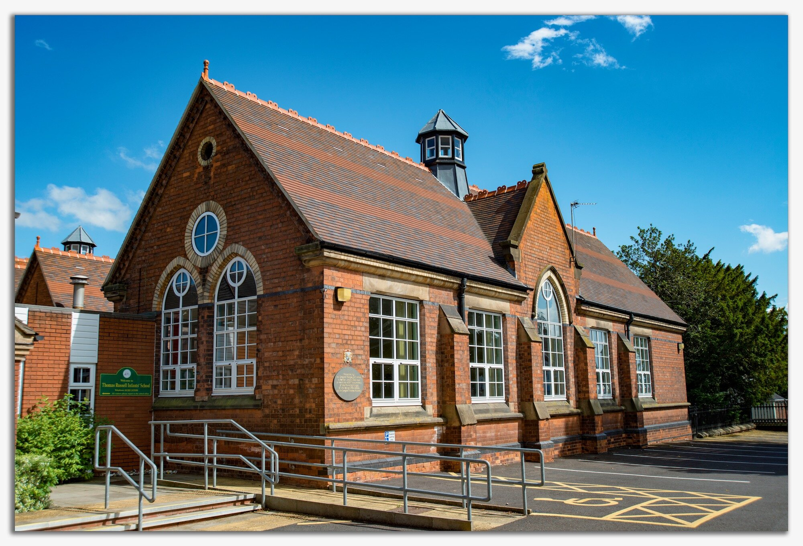
Excite, explore, excel

Slide 15
Thank you!
We look forward to
your child
starting with us in September.

